Slide 1
R Commander (Rcmdr)
Dane Boring
12/6/19

Slide 2
What is it?
Wikipedia: “R Commander is a GUI for the R programming language”
GUI – Graphical User Interface (point and click)
rcommander.com: “R provides a powerful and comprehensive system for analysing data and when used in conjunction with the R-commander it also provides one that is easy and intuitive to use
Dane: it’s between ease-of-use for Excel and the less intuitive coding for more individualized procedures in R

Slide 3
What is a GUI? (compared to R)
A computer running at its most basic is in binary (the 1’s and 0’s you’ve seen referred to in movies)
Nobody (p<0.05) actually uses this. In school, we’re taught how to use the operating system (OS) Windows.
The OS helps the average Joe figure out how to make use of a computer. Thus, we have everything put into a point-and-click visualization (GUI)
Excel is the most commonly used/known way of pointing and clicking your way through data (GUI)

Slide 4
Why is coding (R) better than GUI (Excel)?
It’s free and open source (for R)
It can be automated (imagine a dynamic dataset, like environmental data, that needs to be run through same steps quarterly)
It can be refined to every level from big to minutiae
Huge open source community on Github and Stack exchanges
GUI uses more computer resources to run since it has the graphics and buttons to process and maintain on screen

Slide 5
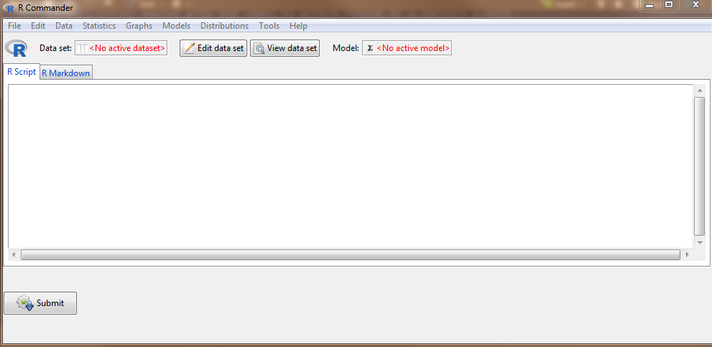
Hybrid approach? Rcmdr
library(Rcmdr) to launch:

Slide 6
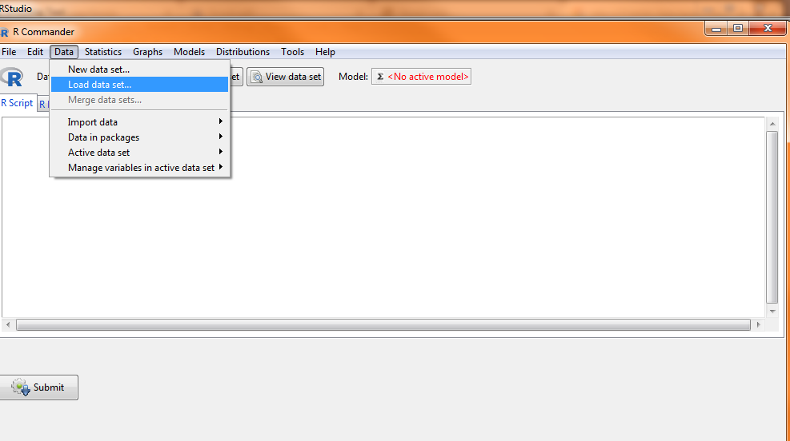
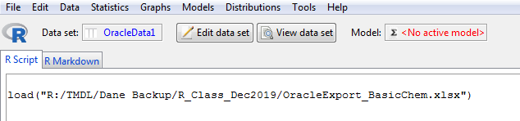
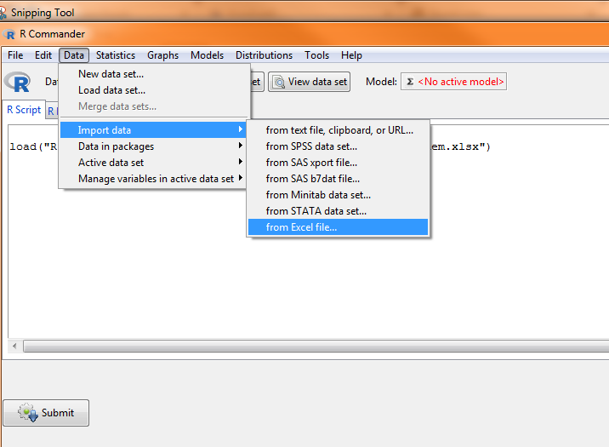
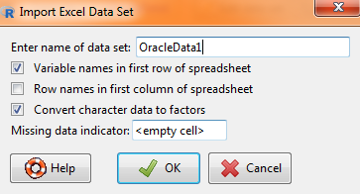
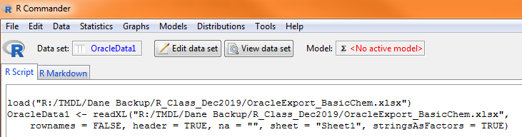
Give it a whirl

Slide 7
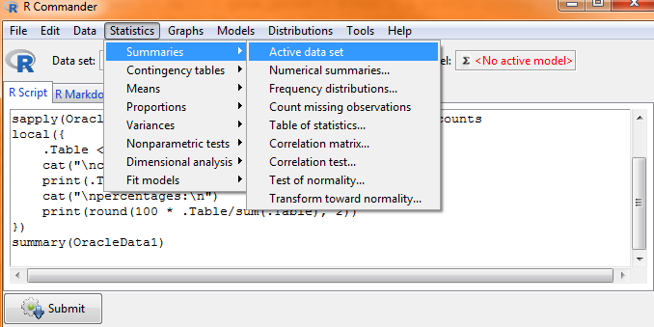
Everything at once:

Slide 8
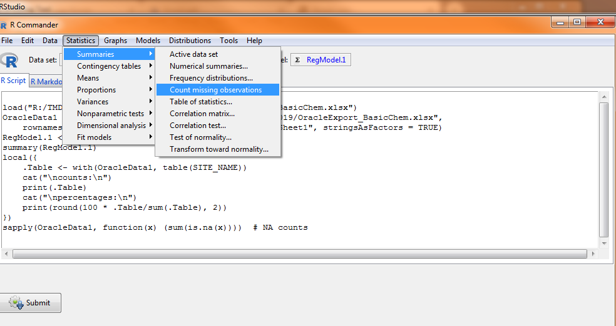
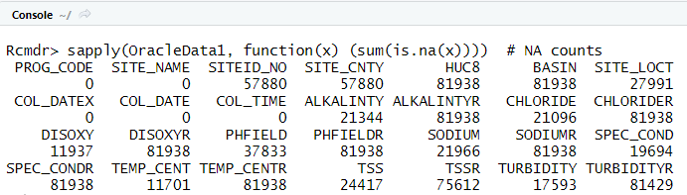
Other exploratory methods:

Slide 9
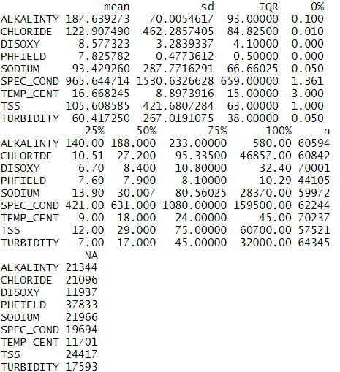
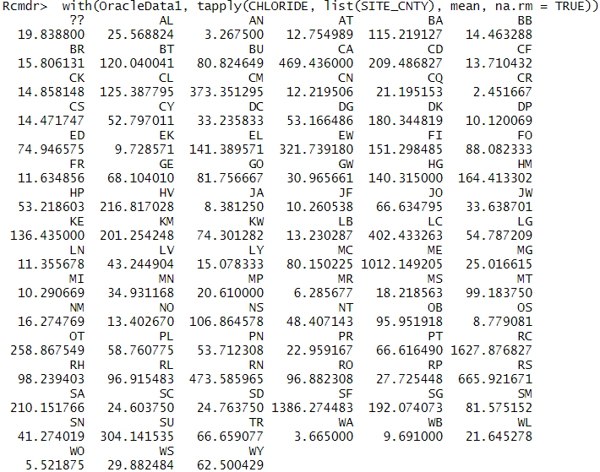
Numerical Summaries
Table of Statistics (means)

Slide 10
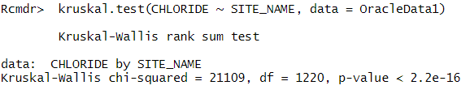
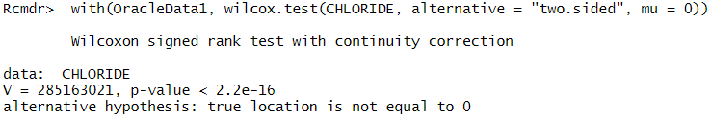
Kruskal-Wallis and Wilcoxon Tests:

Slide 11
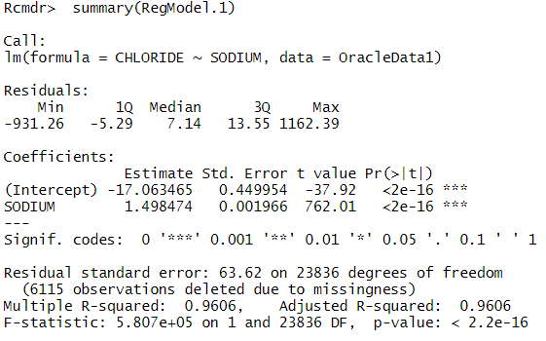
Linear Regression between Na and Cl:

Slide 12
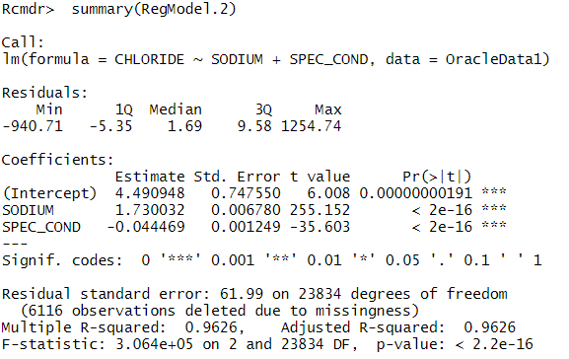
Linear Regression with multiple explanatory variables:

Slide 13
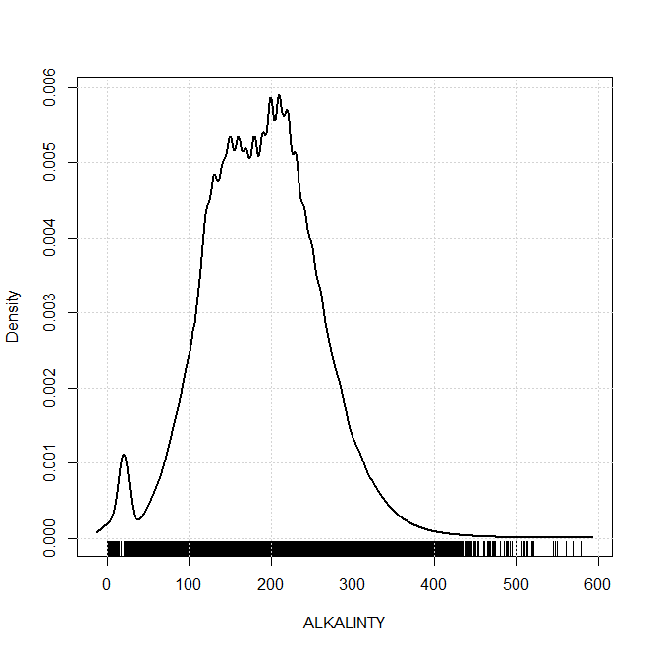
Histogram
Density estimate

Slide 14
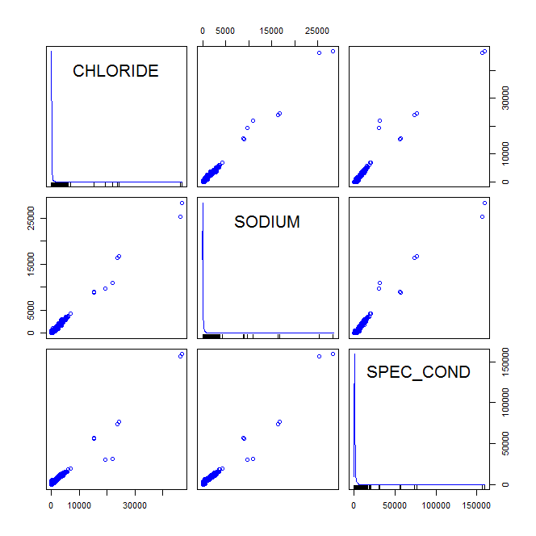
Scatterplot
Scatterplot matrix

Slide 15
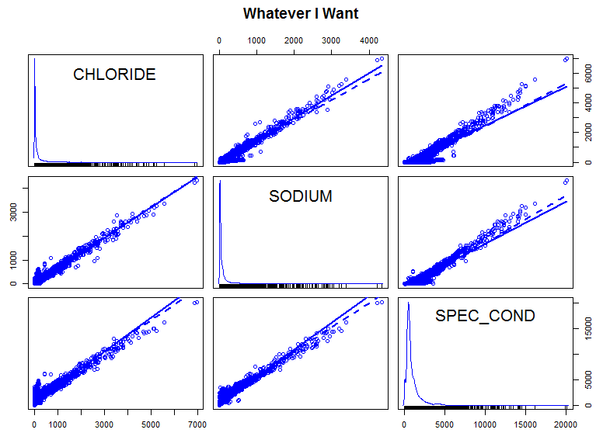
How about a little dressier? Options tab!

Slide 16
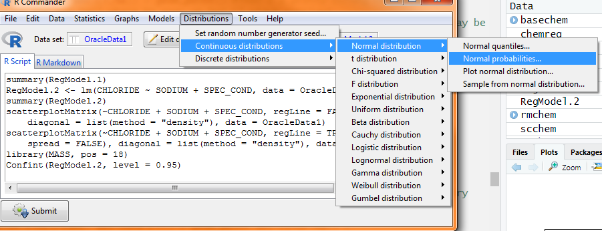
What dat do?
Set random number generator seed:
-Computers are not random. Basically, you can introduce your own bit of randomness setting that number how you like.
Computer generated distributions are a branch of statistics I won’t try to explain for lack of depth on my part, but just know these are here.

Slide 17
Seems great; what’s the snag?
The dataset we loaded is raw
What we put in has to be a finished product ready for the statistical analysis
Not much variety involved
R coding allows near infinite adjustments. We’ve only added a title and couple lines to scatterplot matrix. How about subtitle? A fleet of these matrices for every HUC8? ‘Chloride’ or ‘Cl’ instead of “CHLORIDE” for titles? Choosing tick marks on the axes? Various color adjustments by grouping? Space of axis labels from the axis marks? Presence of axes lines even at all?
We’re only using the basic plotting function here. No interactive plots are going to come out of this, we’ll be missing certain statistical packages not Rcmdr friendly, and besides being free we’re not making much more use of this over Excel.
No automation!

Slide 18
Why Rcmdr if it lacks the full suite of R capability?
Easier getting into a hot tub slowly than jumping in head-first
Coding is different than how we’re taught to use computers in school. You actually have to understand the workings of it to use it best. Going straight from point-and-click to coding is not intuitive and takes time getting used to.
You can click the basic solution into existence there and modify the code for your specifics
Copy and paste to your script then use ?function() to get a start on the arguments to make it your own
It’s a good easy starting point, especially for non-common everyday type users having to remember the coding
Again, it’s a use-it or lose-it method. Coding takes practice and critical thinking, and Rcmdr helps with if you’ve been away from it for a while and lose-it per se.

Slide 19
Dane’s summary
Rcmdr is a useful tool for quick answers to some questions, much like Excel would provide. Additionally, it provides the code you can copy for your own use.
However, it undercuts the usefulness of writing the code vs a GUI approach: OPTIONS
Handling datasets (detection limits, weird stuff, corrections, etc.)
Polished dataset needed in Rcmdr
No automation
Running loops to mass produce plots, results, etc.
Slower to set up for running after first time

